Slide 1
WELCOME TO UNIVPM
Vademecum for international students
Divisione Segreterie Studenti

Slide 2
How to…
This vademecum wants to guide you into the main procedures, tools and services you may need during your career at UNIVPM.
Here, you can find how to:
Ask for the badge and park permit
Consult didactic calendars and lessons timetable
Present your study plan
Get info on your bachelor or master degree course
How to take an exam
Recognition of previous careers and exams
Request a certificate
Graduation exam
Suspend, interrupt or withdraw from studies
Tuition and Fees
Ask for Scholarship and other benefits
Library, internet services, language courses
Students associations, practice sports
Psychological support and disabilities
Useful tools and apps
Registrar’s office contacts

Slide 3
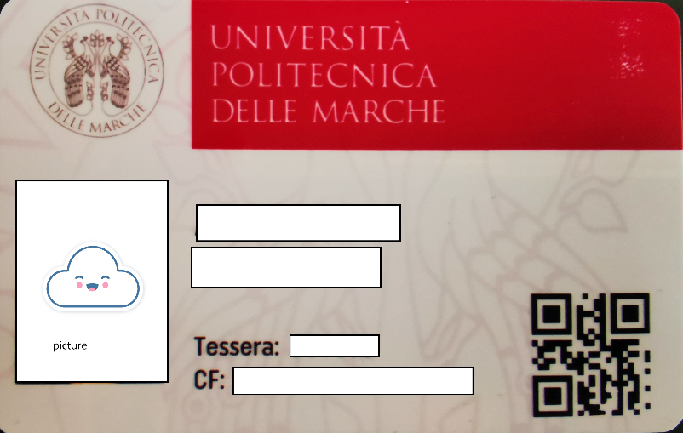
Badge and park permit
After the enrollment, you can collect your university badge at the registrar’s office of your Faculty (check opening days and hours).
If you need a park permit, please, check how to ask for it in your registrar’s office web page.

Slide 4
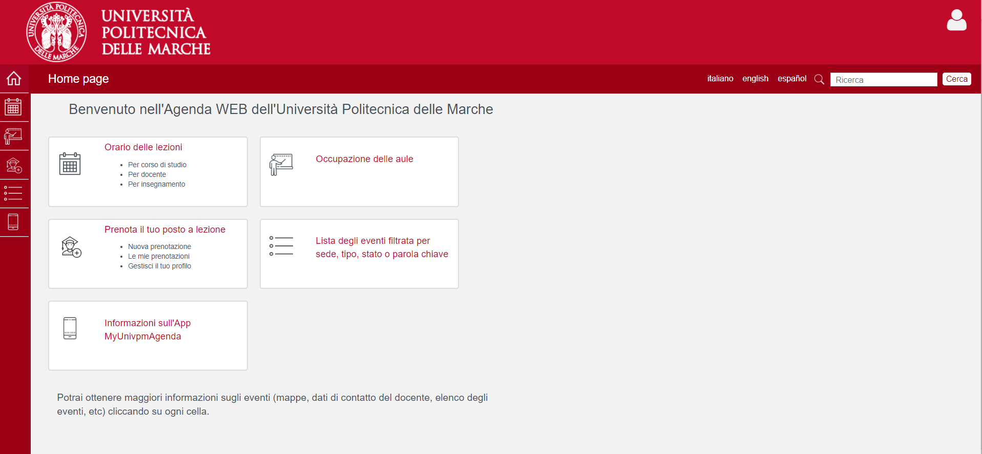
Didactic calendars and lessons timetable
Didactic calendars: enter on the web site of your Faculty, click on “Didattica” and then choose the appropriate link referred to your course.
Consult lessons timetable in the APP MyUnivpm Agenda.
You can also reserve your seat.

Slide 5
Present your study plan
In November, enrolled students can submit their study plan, with the choice of exams and elective teaching activities, by entering their reserved area and following the dedicated procedure.
Please, check the methods and criteria for submitting the study plan on the web page of your registrar’s office.

Slide 6
Info on your study course
On your Faculty website,
you can find all the information on your course (presentation, calendars, study plan, activities, contacts…).
Click on “Didattica” > “Offerta formativa” and choose the course you’re interested in.

Slide 7
How to take an exam
To register for an exam session, you have to enter in your reserved area and choose the exam you want to take.
Please, before registering for an exam, check which are the bridging course (propedeuticità) required by your study plan.
You can check also dates and timetables of your exams in the App My Agenda.

Slide 8
Recognition of credits from previous careers
If you have a previous university career, you can ask the recognition of academic credits. The recognition can be either integral or partial. Please, check conditions and how to present the request on the web page of your registrar’s office.

Slide 9
Request a certificate
If you need to ask for a certificate regarding your academic career, you can contact the registrar’s office of your Faculty or, in alternative, visit the web site, download and submit the appropriate form.
When asking, please specify the purpose of your request. In some case you may need to present a stamp duty.

Slide 10
Graduation exam
In order to obtain a degree, a specialist degree and a master's degree, the student must pass a final exam, the content and methods of which are established by the Didactic Regulations of the Degree Programs.
Students can apply exclusively online, from the reserved area at the "Laurea" link on ESSE3 WEB, in the periods expressly provided for each graduation session and published in each Registrar’s office webpage.
Only students who have passed all the exams in their study plan, including the final internship exam, are admitted to the final exam of the degree course.

Slide 11
Suspension, interruption and withdrawal from studies
Interruption: The student is allowed to interrupt his studies, which takes place through the failure to renew the enrollment, or the failure to pay the first installment of taxes and contributions, for at least two consecutive academic years. To resume your studies, after two or more years, you will need to contact the Student Secretariat of your Faculty to calculate the recognition fee. For more information, ask the Student Secretariat or consult art. 27 of the Student Regulations.
Withdrawal: If you have decided to give up your studies permanently, you can contact the Student Secretariat of your Faculty. Remember that with the renunciation, your permit for study reasons cannot be renewed. Therefore, if you wish to change your course of study at the same or another University, you must ask for the changeover or transfer to another course!
Suspension: the Univpm Student Regulations (Article 26) provide that you can temporarily suspend your studies, for a period of at least one year, if:
A) you intend to enroll or have been admitted to one of the following courses: I and II level masters; specialization school; PhD; study course at Italian military training institutes (also with agreements with public universities); university level study program at a foreign university; course provided for by Ministerial Decree 249/2010.
B) In the following cases:
¤ by the birth or adoption of a child in the year corresponding to or following the date of birth or adoption;
¤ for serious and duly documented infirmities, for the academic years in which the infirmity occurred;
¤ for carrying out civil or military voluntary service, for the academic year or academic years in which it takes place.
The application for suspension must be presented to the Registrar office within the enrollment deadline for the academic year. For more information, contact the Registrar office of your Faculty.

Slide 12
Tuition and Fees
The payment of the annual university fees is divided into three installments, of which the first one (€ 156) is the same for every student, while the second and third installments are calculated on the basis of the income requirements (ISEE), merit and particular conditions of the student.
The installments and related deadlines are visible in your reserved area on Esse3web under the heading "Secretariat"> Payments. Be careful! The delay in the payment of the installment involves the payment of a fine!
For more info, please, visit “TASSE E CONTRIBUTI” or ask to Diritto allo Studio Office Email: dirittoallostudio@univpm.it

Slide 13
Scholarship and other benefits
ERDIS (The Regional Body for the Right to Education), every year, offers students the opportunity to take scholarships, as well as various benefits regarding accommodation, transports and university canteens. You can consult the calls (also in English) on www.erdis.it
More information on accommodation and university canteens:
UNIVERSITY RESIDENCES: consult the website www.erdis.it ;
PRIVATE RESIDENCES WITH AGREED FEE: you can ask for help and consult the Informa Giovani of Ancona;
CANTEENS: In Ancona there are 3 university canteens in Via Petrarca (near the Monte Dago pole), in Via Matteotti (near the Faculty of Economics), in Via Tenna 26 (near the Faculty of Medicine and Surgery).
TRANSPORTS: see benefits for students here.

Slide 14
Library, internet services, language courses
The Centro di Ateneo di Documentazione (University Documentation Center) and the 4 university libraries offer a vast opportunity to consult books, documents, national and international newspapers that you can also borrow. For more information, consult the University Documentation Center website or visit your Faculty Library.
In each Faculty there is a computer lab with PCs and internet connection. For more information on IT services, you can consult the pages of the Centro Servizi Informatici (IT Service Center).
The Centro di Supporto per l'Apprendimento delle Lingue (Language Learning Support Center) offers international students the opportunity to take Italian language courses and take exams (CELI), as well as courses and certifications in other European languages.

Slide 15
Students associations, practice sports
University student associations offer cultural and recreational activities, as well as support students in all matters relating to their university career. To find out about student associations in UNIVPM click here!
The University Sports Center (CUS) offers students the opportunity to practice team and individual sports. Consult the courses available on the CUS Ancona website or contact the CUS desk at your Faculty.

Slide 16
Psychological and disabilities support
UNIVPM has activated a free listening and psychological support desk for all enrolled students, where, thanks to the help of an expert, it is possible to take advantage of useful support to deal with situations of discomfort. The SAP works jointly with the Reception service for disabled students, which internally includes the service dedicated to Specific Learning Disorders (D.S.A.). For info, just send an email to sap.ascoltostudenti@sm.univpm.it indicating your name, surname and a telephone number.
UNIVPM has activated a specific service aimed at welcoming, assisting and integrating students with disabilities enrolled in the University's degree courses to make schooling easier and more accessible. For information and contacts: info.disabili@univpm.it

Slide 17
Useful tools and apps!
My UNIVPM Agenda: Thanks to MyUnivpm you can:
Consult the lesson timetable
Reserve your place in class
Consult your reservations based on the profile created
My UNIVPM: is the official app to manage your career at UNIVPM. With the app you can:
Consult the training offer
Consult the news for students
View the available sessions
Book you for exams
Accept / Reject votes
Consult the timetables and contacts of the student secretariats
DOWNLOAD: https://www.univpm.it/Entra/Universita_Politecnica_delle_Marche_Home/Univpm_App

Slide 18
Useful tools and apps!
Esse3web is the web area where you can manage your student career.
University institutional e-mail: once enrolled, you will be assigned an institutional e-mail from the university s+matricola@studenti.univpm.it and you will have access to the Microsoft Office 365 portal.
“Teams” APP: is the platform used by teachers for the transmission of lessons in streaming.
Moodle E-LEARNING PLATFORM
All students regularly enrolled in our University can access the E-LEARN platform. Through this platform, you can:
access the available material (handouts, audio recordings, collections of useful links, etc.);
dialogue with colleagues and the teacher through tools such as forums or chats;
carry out scheduled educational activities such as homework, group work, verification questionnaires.

Slide 19
Registrar’s offices contacts
Agriculture
Economics
Engineering
Medicine and
Surgery
Sciences

